Slide 1
Resume Classification
Group Members :
Miss. Sakshi Rajendra Shirahatti
Mrs. Pooja Nitin Kathole.
Mr. Rohith Vaddeti
Mr. Rajiv ranjan Kumar
Mr. Roger Barreto
Mr.Abhijit Shirish Kharade

Slide 2
Contents:
Business Objective:
Data Summary
EDA/Data Cleaning
Model Building : 1) Support Vector Machine
2) Random Forest
3) K-Neighbors Classifier
4) Naive Bayes
Deployement

Slide 3
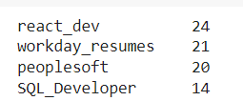
Business Objective :
The document classification solution should significantly reduce the manual human effort in the HRM. It should achieve a higher level of accuracy and automation with minimal human intervention Sample Data Set Details: Resumes and financial documents
Data Summay :

Slide 4
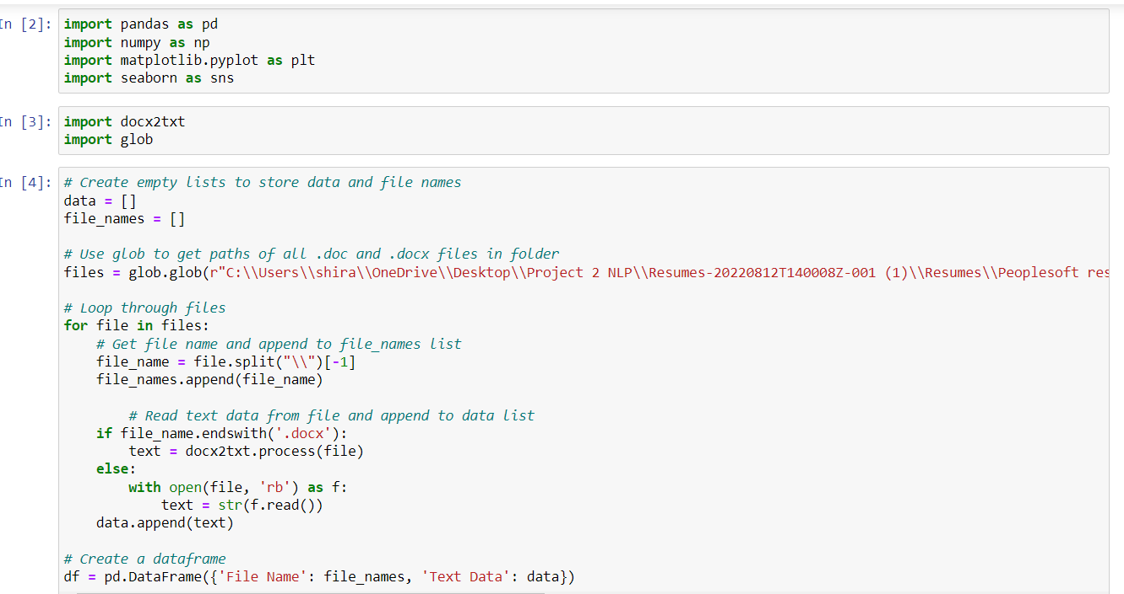
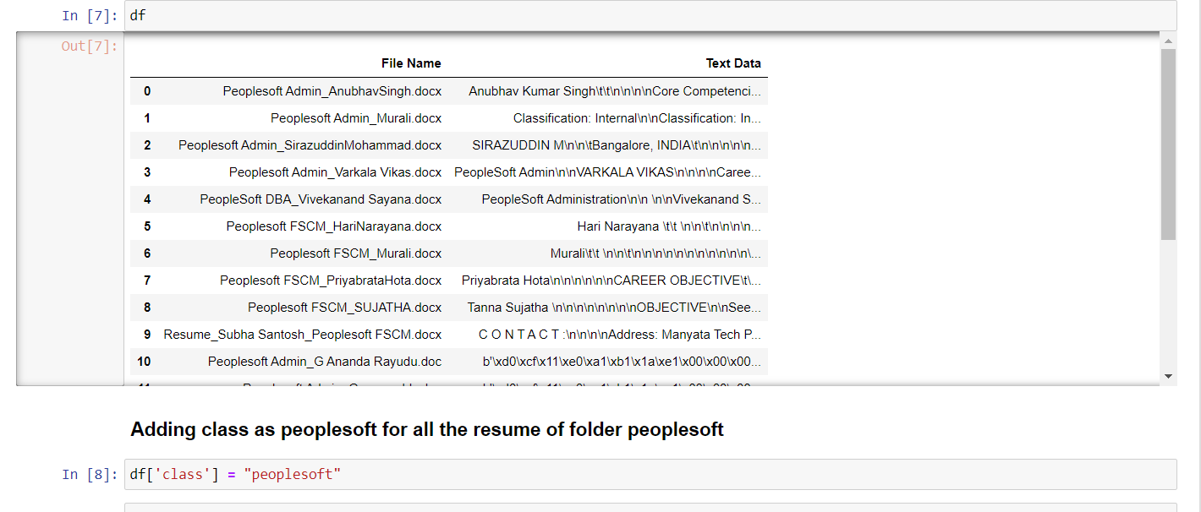
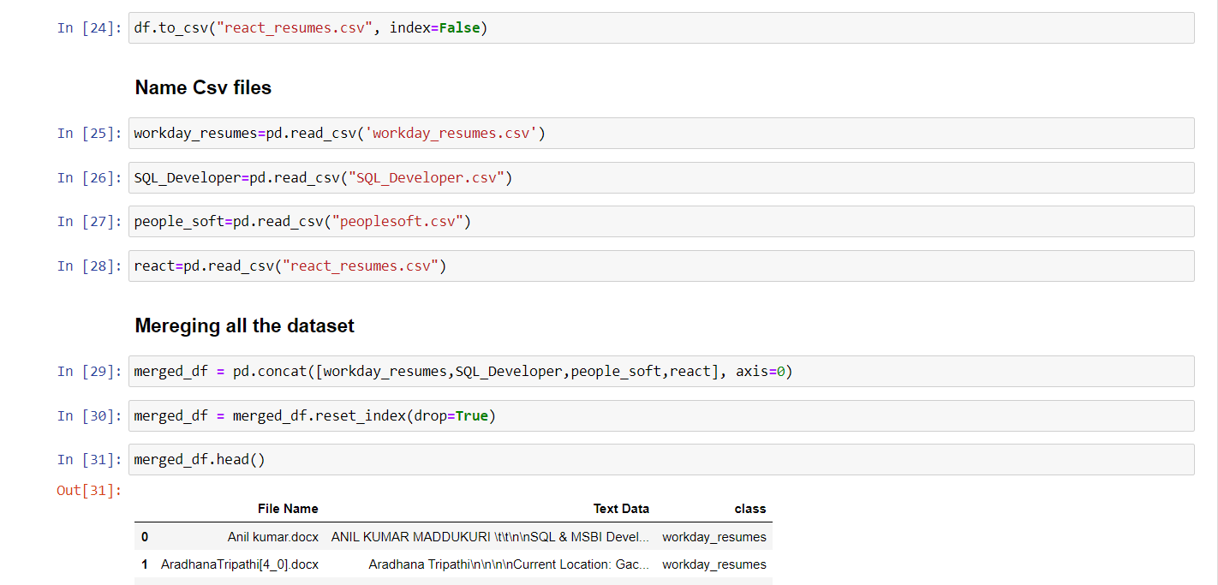
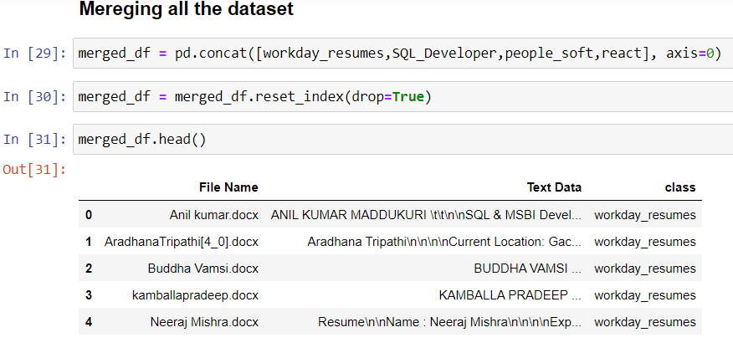
EDA:

Slide 5
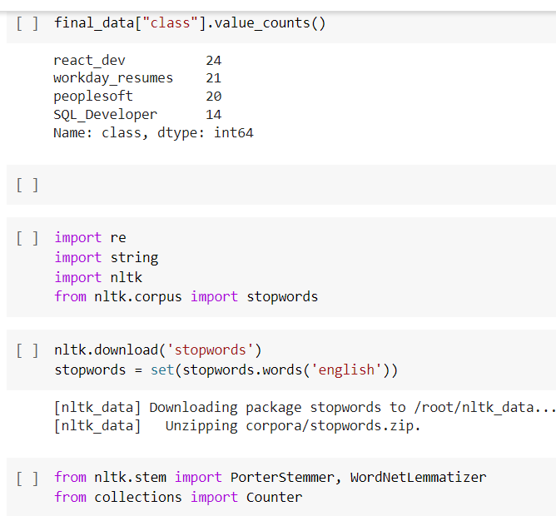
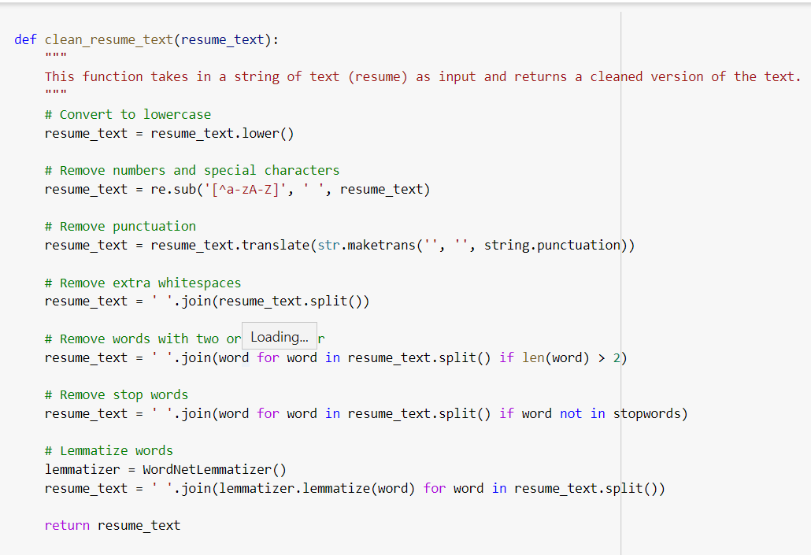
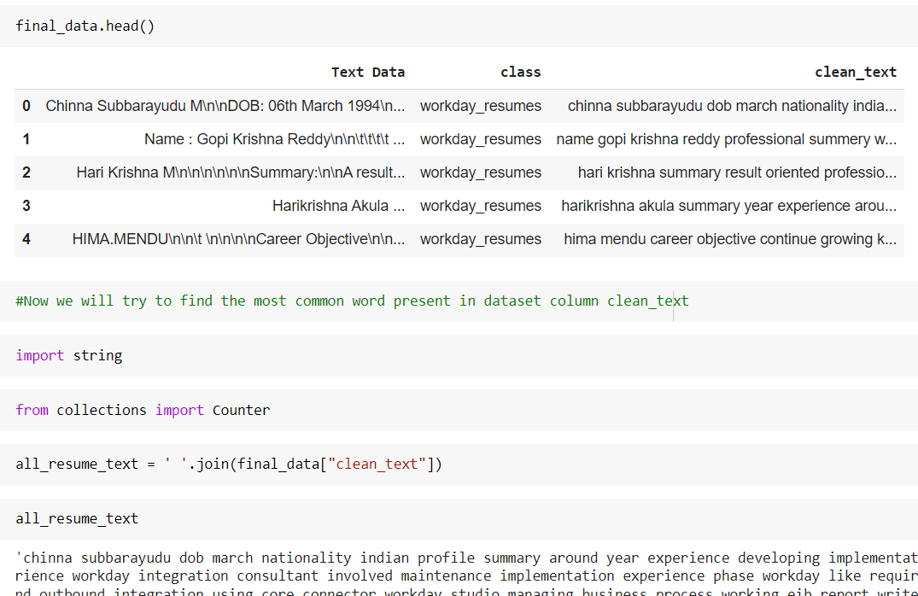

Slide 6
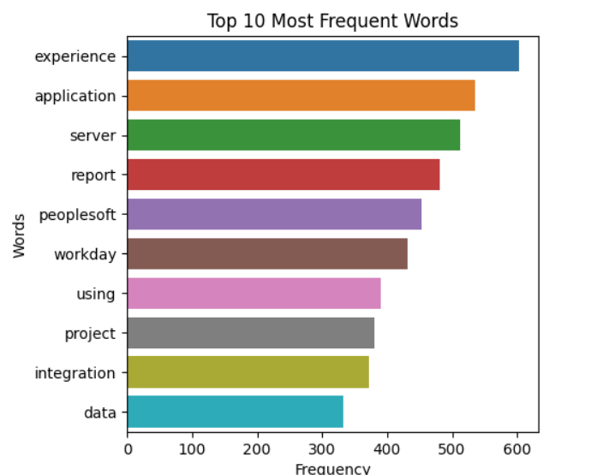
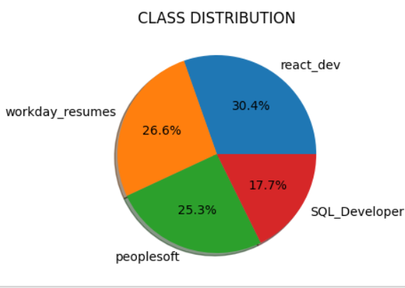
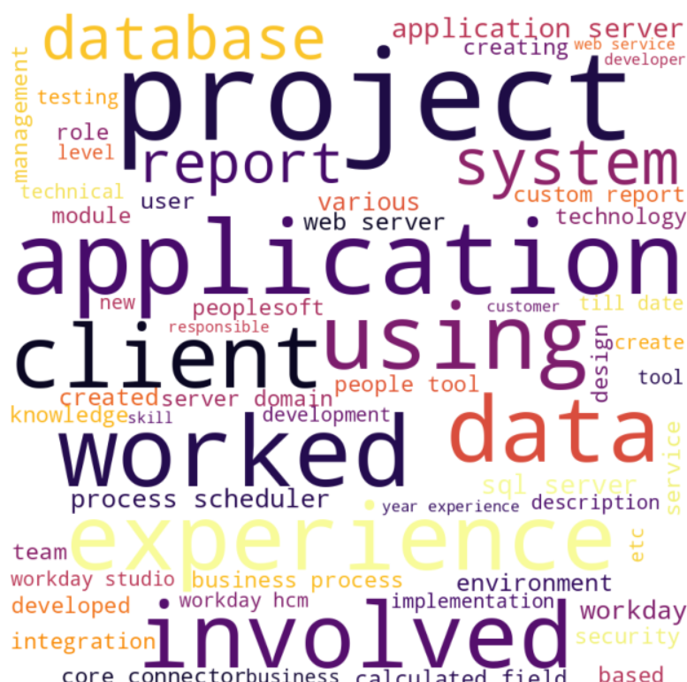
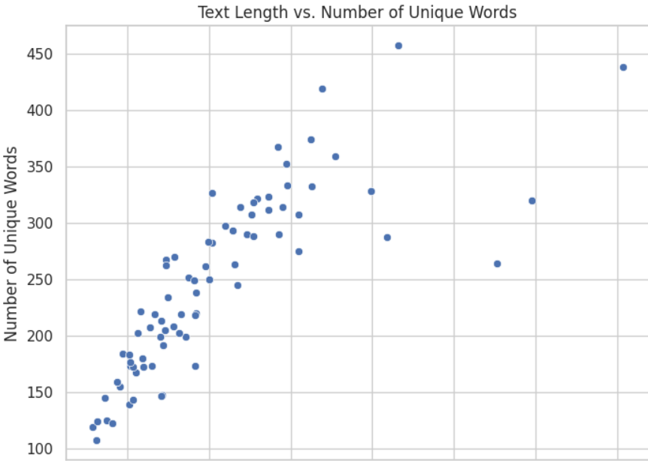
Visualization:

Slide 7
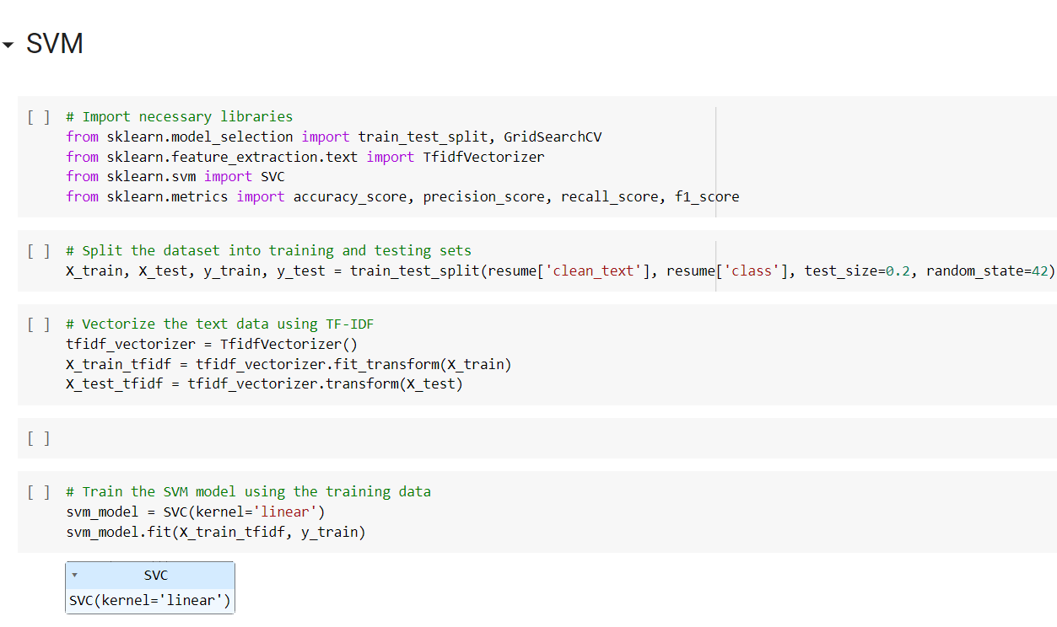
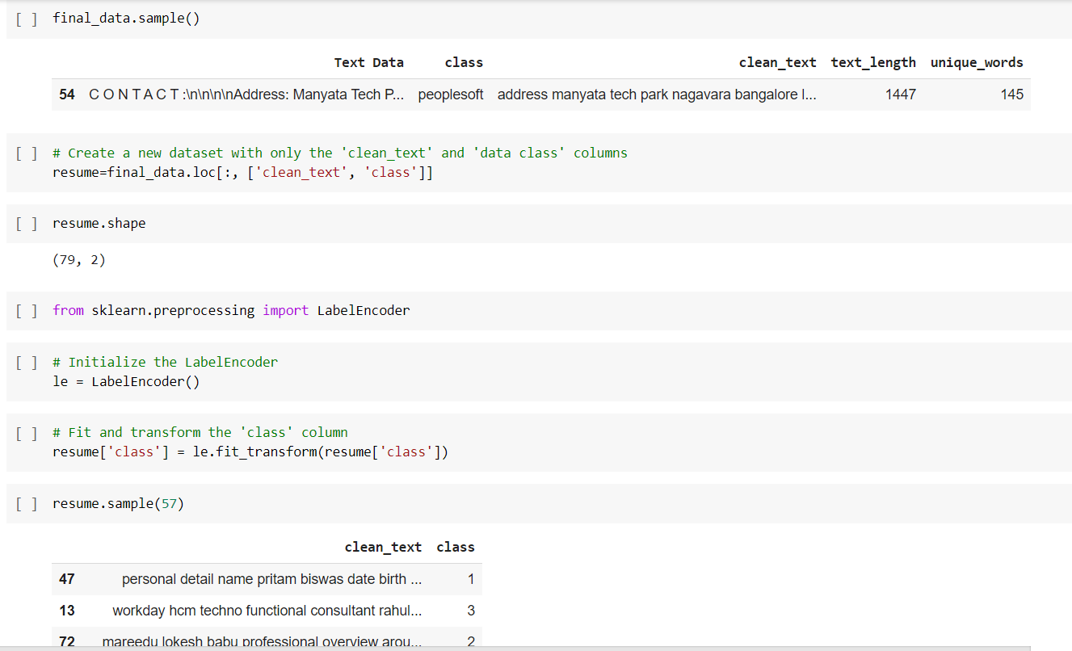
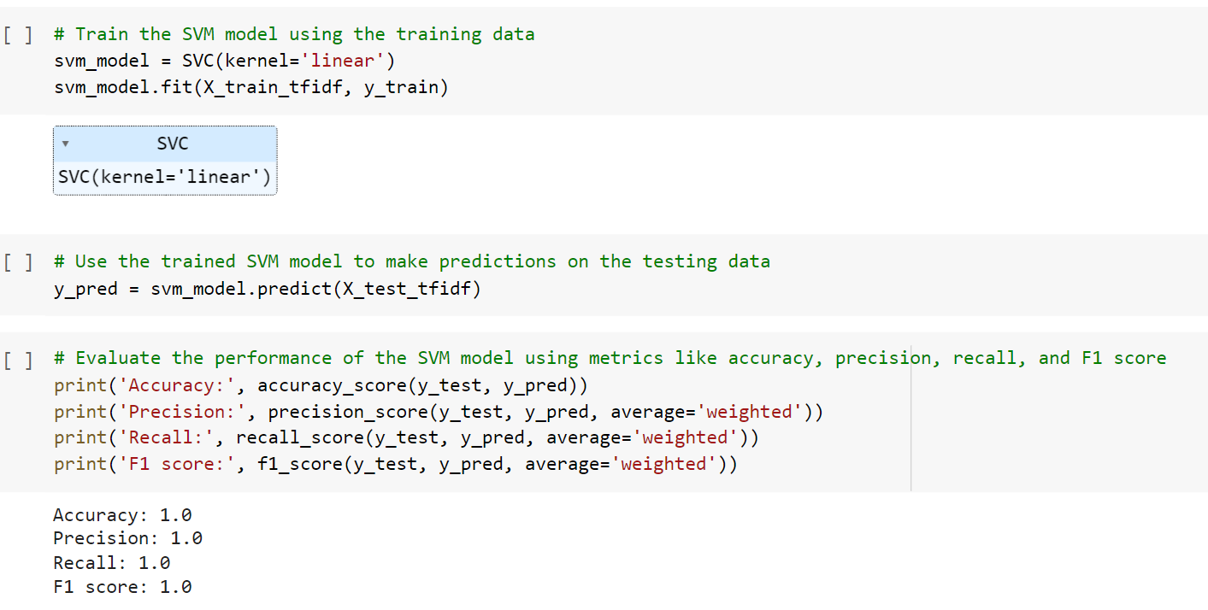
Model Building :

Slide 8
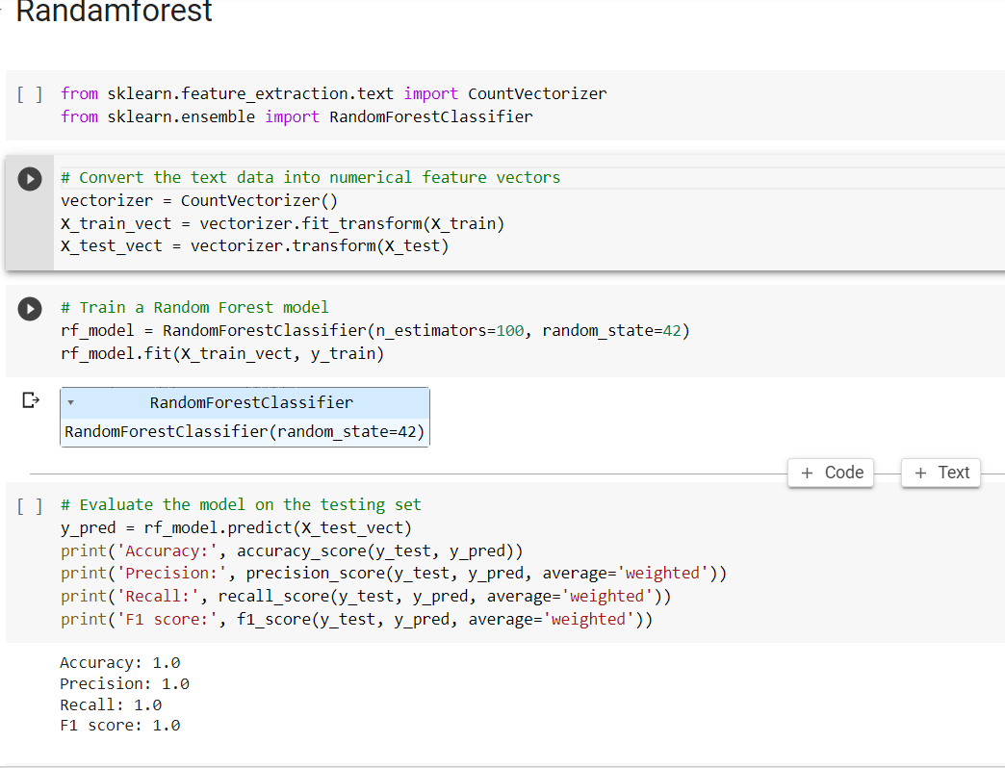
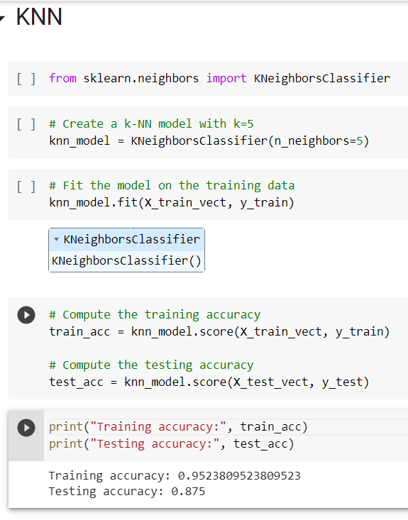
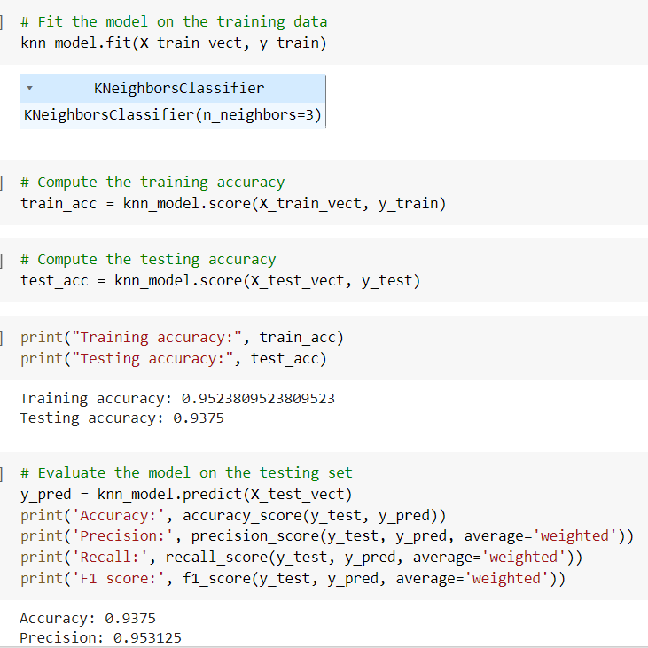

Slide 9
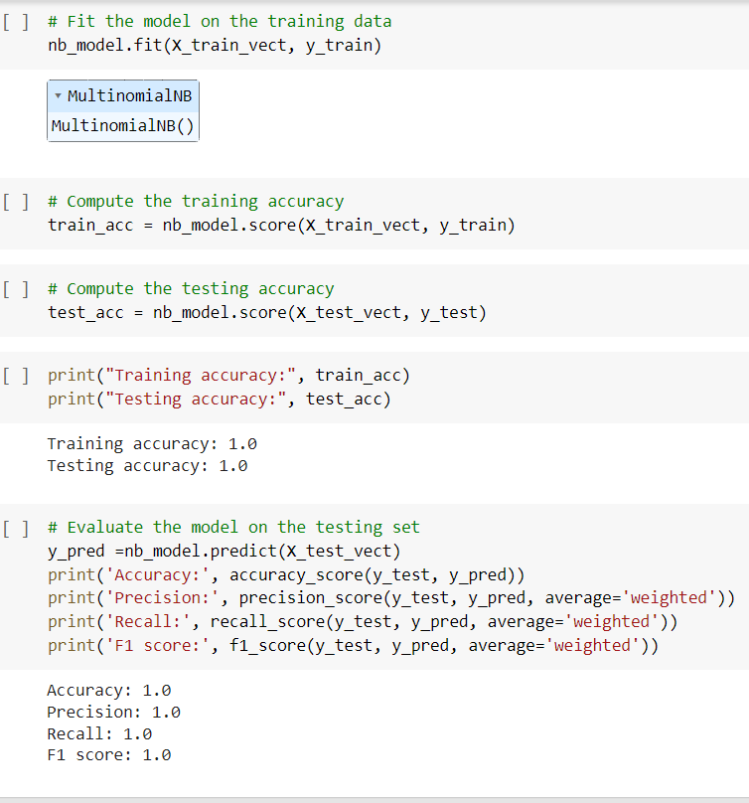
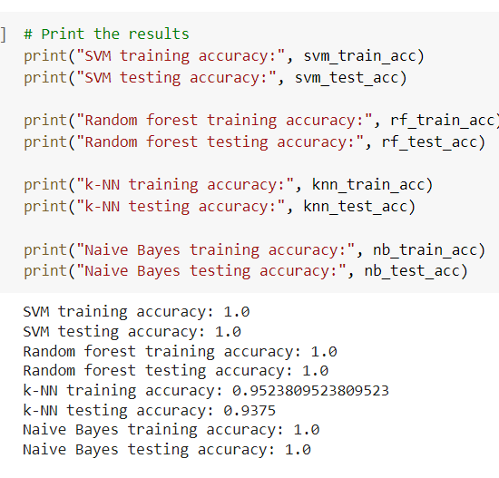

Slide 10
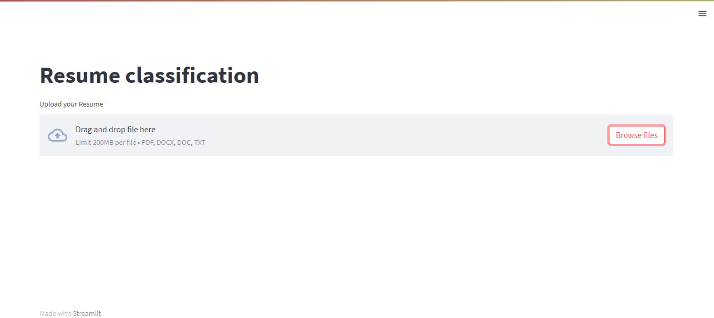
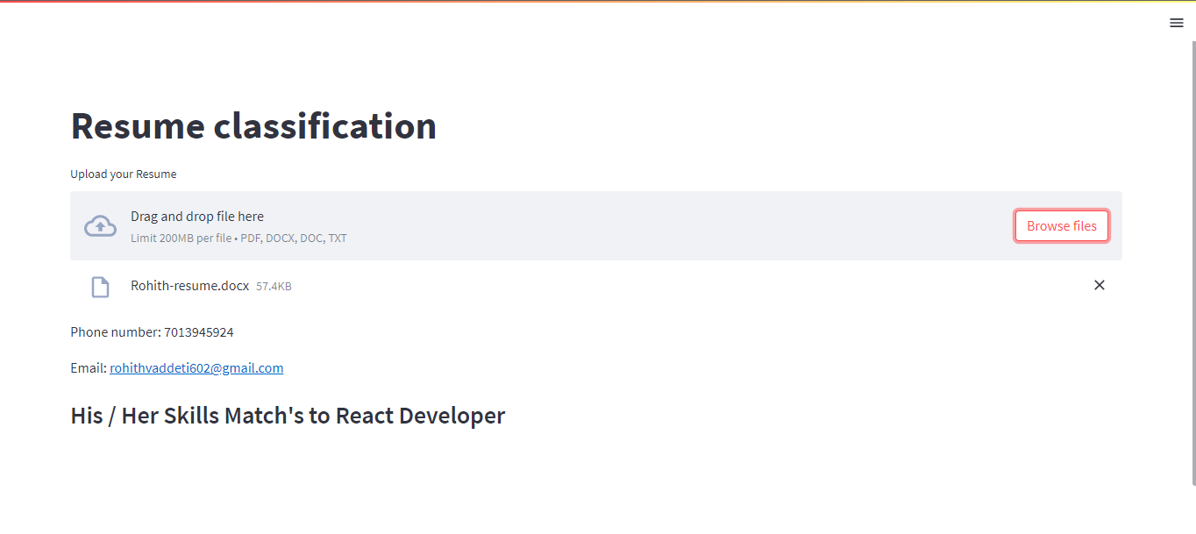
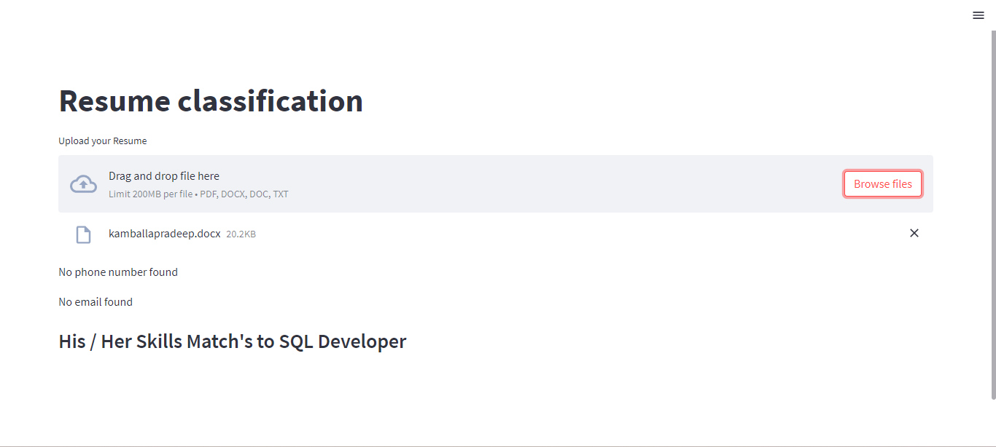
Deployement:

